Slide 1

MEET THE
Teacher
PARENT MEETING
YEAR 5

Slide 2


Spiral Leadership Team

Slide 3
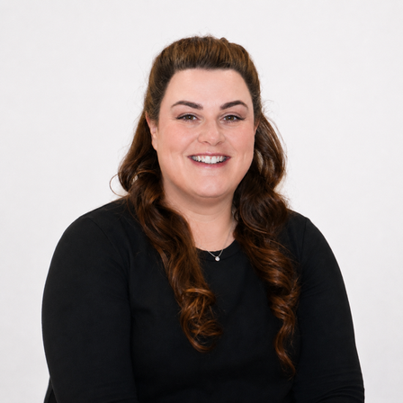
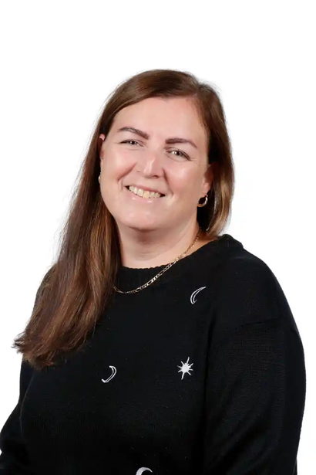
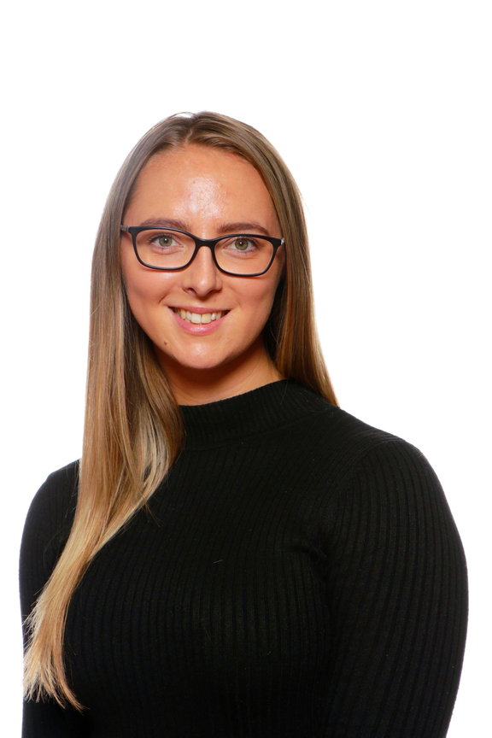
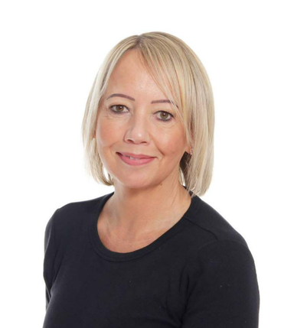
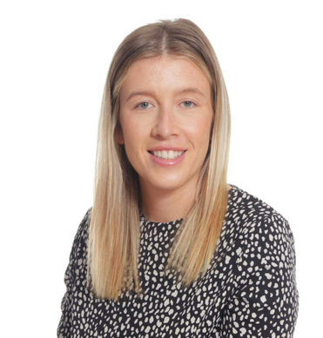
Forres Leadership Team
Mrs Fitts
Headteacher
Mrs Loveday
SENDco
Miss Bright
EYFS/KS1 Lead
Miss Goldsmith
Deputy Headteacher
Mrs Tollervey
Pastoral Lead

Slide 4
MEET THE
Year 5 Teaching Team

Slide 5

Vision and Values

Slide 6
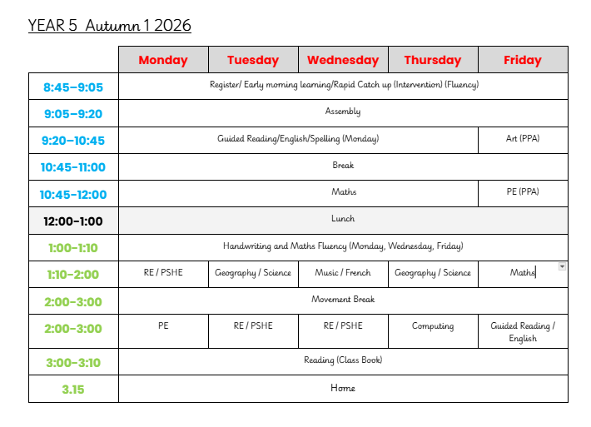
A typical day in Year 5

Slide 7

Curriculum Overview

Slide 8
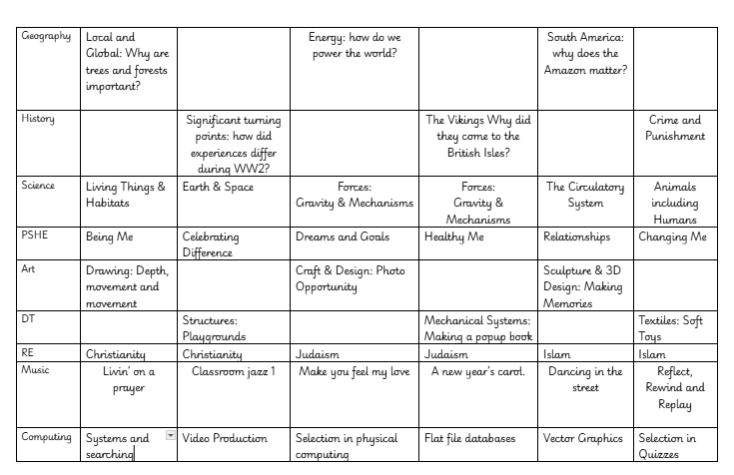
Curriculum Overview

Slide 9
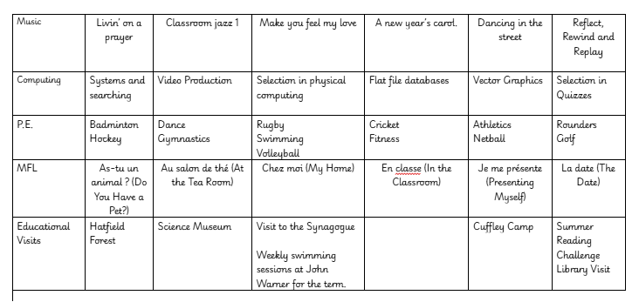
Curriculum Overview

Slide 10
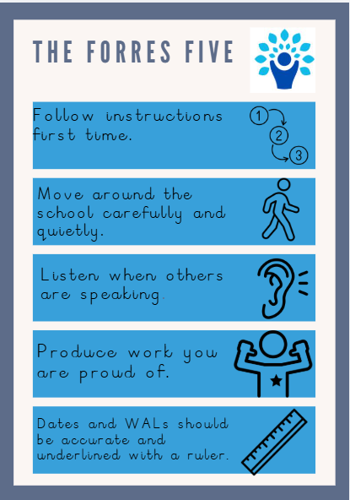
The Forres Five

Slide 11




Reading
Independent Level (95% to 100% accuracy): The child knows almost every word. They can read this book easily on their own without help

Slide 12
Home Learning
•As a school we believe in children practising their basic skills and do not set onerous homework to complete.
•Our expectation is that children read every day, at least 5 times a week and practise their spellings.

Slide 13
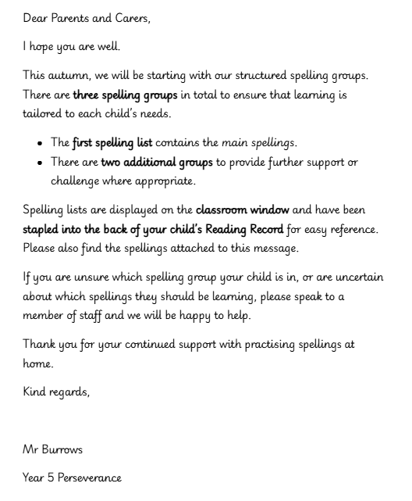
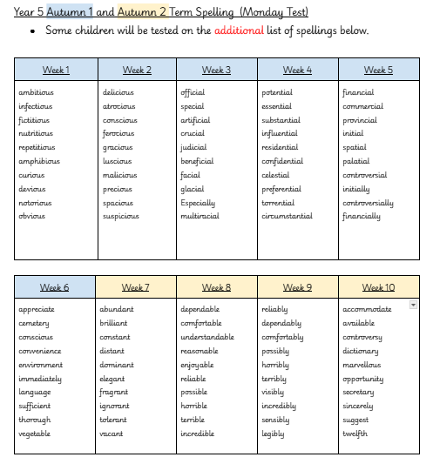
Weekly Spelling

Slide 14
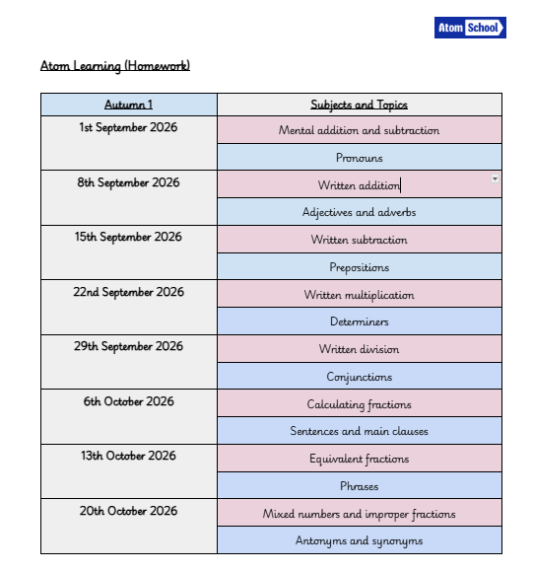
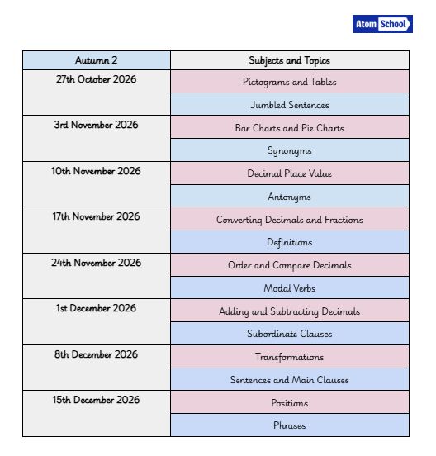
Home Learning

Slide 15
Attendance
Small amounts of absence quickly add up
90% attendance means missing around 1 day every two weeks.
Over a school year, that's approximately 19 days of learning missed.
Across primary school, this can amount to almost half a year of education.
Strong attendance leads to better achievement
Children who attend school regularly are more likely to reach expected standards in reading, writing and maths.
Better attendance in primary school lays the foundation for success in secondary school and beyond.
School is about belonging | Parents and schools are partners
Children who attend regularly are more likely to: feel part of the school community take part in clubs and events develop a sense of pride and belonging. | The biggest impact on attendance comes from families and schools working together to: establish consistent morning routines communicate early about concerns support children who may be anxious celebrate good attendance.

Slide 16
Allergies
-No food will be given out in school, so please no edible items for birthdays or celebrations.
-We are a nut free school, please no items containing nuts in packed lunch boxes.
-All educational visits will be carefully planned and prepared for, should your child have an allergy.
-All staff will be aware of Health Care plans for children with allergies and follow accordingly.

Slide 17

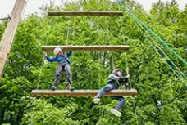
Enrichment Opportunities

Slide 18


Enrichment Opportunities

Slide 19
Enrichment Opportunities

Slide 20
Statutory Assessments
EYFS: Reception Baseline
(6 weeks into Autumn 1)
Year 1 Phonics Screening - June
Year 2 Phonics Re-screening - June
Year 4 Multiplcation Check - June
Year 6 SATs - Week beginning Monday 10th May 2027

Slide 21
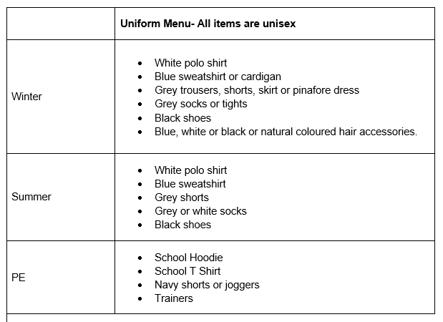
Uniform

Slide 22
Communication at Forres
Throughout the year we will communicate in a variety of ways:
•Face to Face
•Marvellous Me
•Email
•Newsletters
•Letters
•Website
•Phone calls and Text Messages

Slide 23
Any questions?

