Slide 1

MEET THE
Teacher
PARENT MEETING
YEAR 1

Slide 2

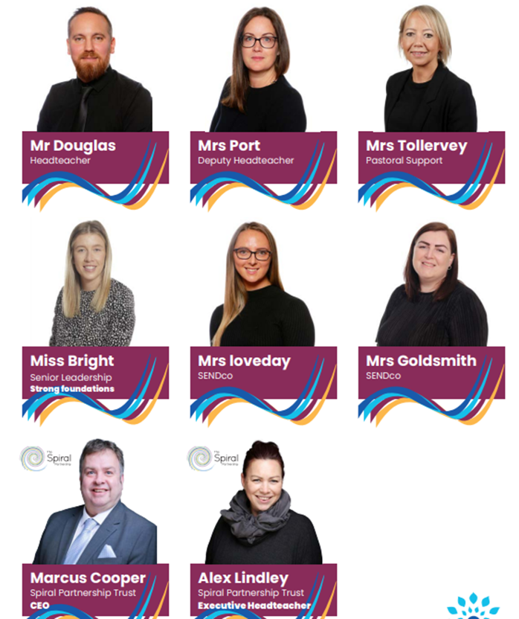
Spiral Leadership Team

Slide 3
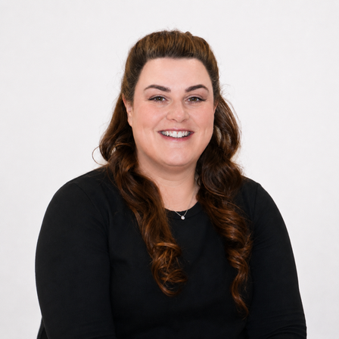
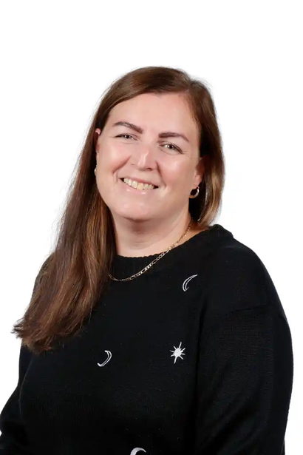
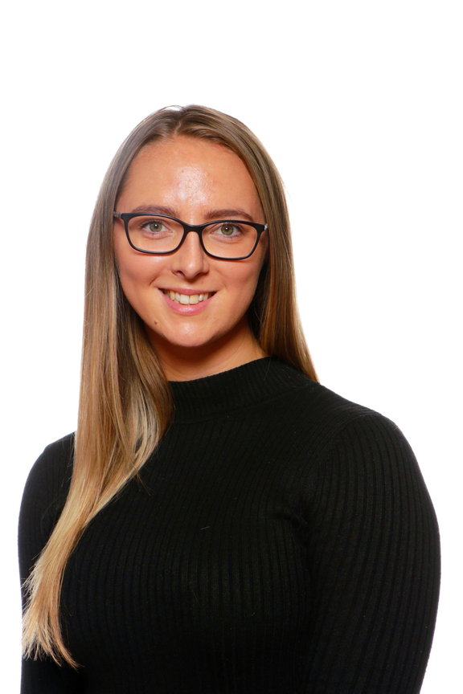
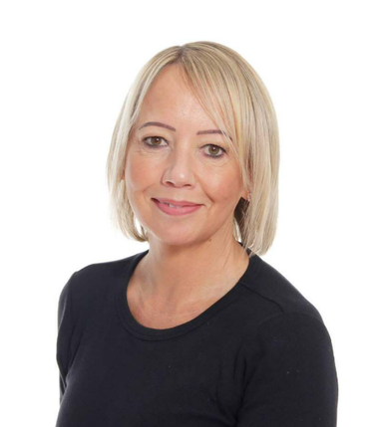
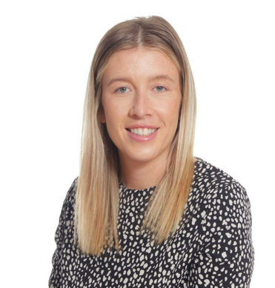
Forres Leadership Team
Mrs Fitts
Headteacher
Mrs Loveday
SENDco
Miss Bright
EYFS/KS1 Lead
Miss Goldsmith
Deputy Headteacher
Mrs Tollervey
Pastoral Lead

Slide 4
MEET THE
Teaching Team
Mrs K
Mrs Wannell

Slide 5

Vision and Values

Slide 6
A typical day in Year 1
8:45am-9am: Early Morning work
9.05-9.20am: Assembly
9.20-10:30am: Maths
10.30-10.45pm: Break
10:45-11:05pm: Handwriting
11:10-12:00pm: English
12-1.00pm Lunch
1-2pm: PE
2-3pm: Science
3-3.15pm: Class Book

Slide 7
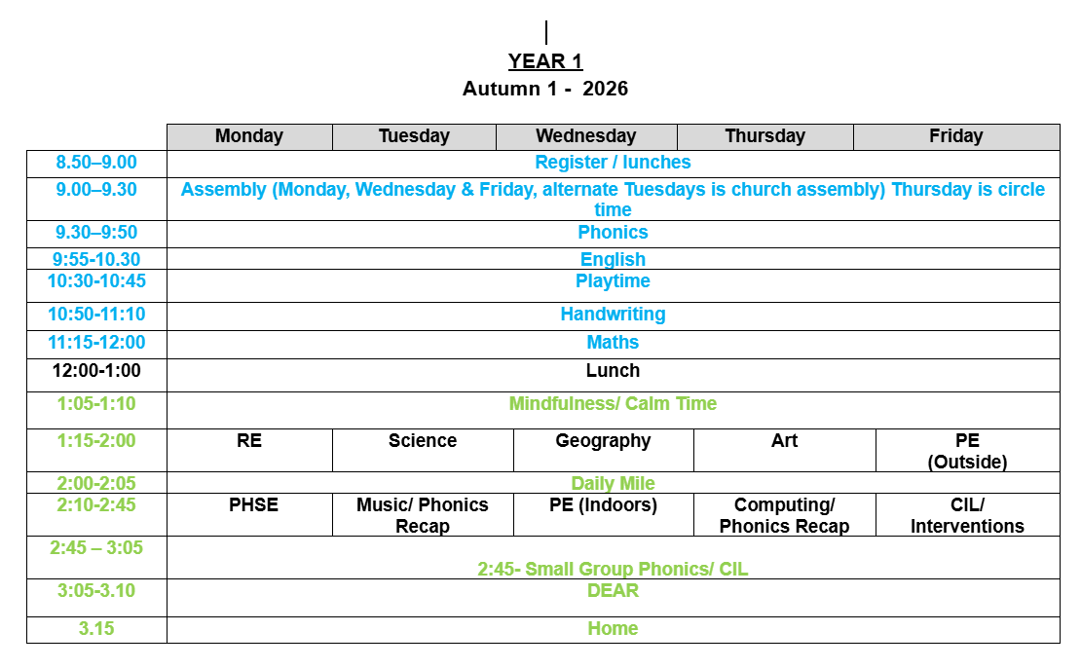
Weekly Timetable

Slide 8

Curriculum Overview

Slide 9
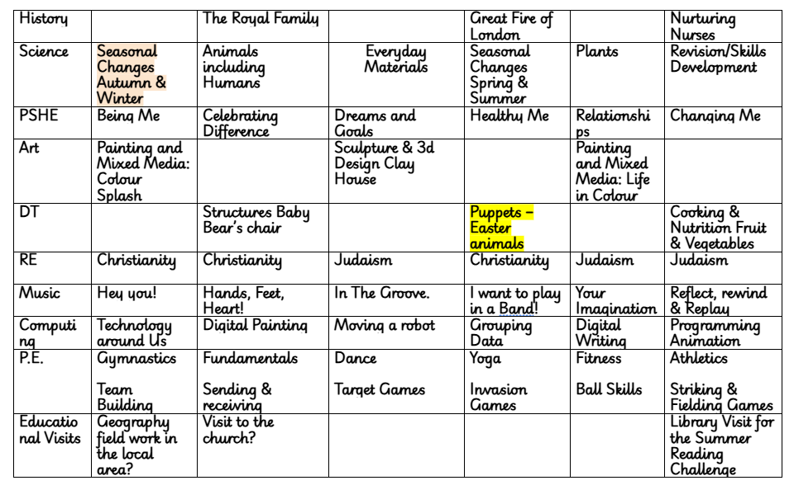
Curriculum Overview

Slide 10
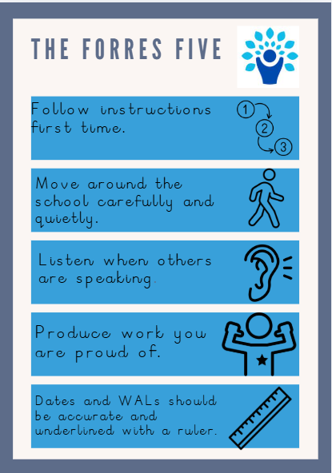
The Forres Five

Slide 11
Phonics, Early Reading,Reading
Phonics
Children will continue to develop their phonics knowledge through daily sessions.
We will learn new sounds and different ways of spelling them.
Children will practise blending sounds to read and segmenting sounds to spell.
We will regularly revisit sounds to build confidence and fluency.
Early Reading
Children will read phonically decodable books linked to the sounds they have been learning.
We will focus on developing accuracy, fluency and expression when reading.
Re-reading books helps children build confidence and read more fluently.
We will also share a wide range of stories to develop vocabulary, comprehension and a love of reading.
Reading at Home
Reading regularly at home, even for 10 minutes a day, makes a big difference.
Encourage children to use their phonics skills to work out unfamiliar words.
Talk about the book and ask questions to check understanding.
Please continue to read stories to your child, even when they can read independently.
Most importantly, make reading a positive and enjoyable experience.

Slide 12
Home Learning
•As a school we believe in children practising their basic skills and do not set onerous homework to complete.
•Our expectation is that children read every day, at least 5 times a week and practise their spellings.

Slide 13
Attendance
Small amounts of absence quickly add up
90% attendance means missing around 1 day every two weeks.
Over a school year, that's approximately 19 days of learning missed.
Across primary school, this can amount to almost half a year of education.
Strong attendance leads to better achievement
Children who attend school regularly are more likely to reach expected standards in reading, writing and maths.
Better attendance in primary school lays the foundation for success in secondary school and beyond.
School is about belonging | Parents and schools are partners
Children who attend regularly are more likely to: feel part of the school community take part in clubs and events develop a sense of pride and belonging. | The biggest impact on attendance comes from families and schools working together to: establish consistent morning routines communicate early about concerns support children who may be anxious celebrate good attendance.

Slide 14
Allergies
-No food will be given out in school, so please no edible items for birthdays or celebrations.
-We are a nut free school, please no items containing nuts in packed lunch boxes.
-All educational visits will be carefully planned and prepared for, should your child have an allergy.
-All staff will be aware of Health Care plans for children with allergies and follow accordingly.

Slide 15
Enrichment Opportunities
Local Walk – Looking at human/ physical features in our local area.
Church visit – Autumn 1/2

Slide 16
Statutory Assessments
EYFS: Reception Baseline
(6 weeks into Autumn 1)
Year 1 Phonics Screening - June
Year 2 Phonics Re-screening - June
Year 4 Multiplcation Check - June
Year 6 SATs - Week beginning Monday 10th May 2027

Slide 17

Uniform

Slide 18
Communication at Forres
Throughout the year we will communicate in a variety of ways:
•Face to Face
•Marvellous Me
•Email
•Newsletters
•Letters
•Website
•Phone calls and Text Messages

Slide 19
Any questions?

