Slide 1

MEET THE
Teacher
PARENT MEETING
YEAR 6

Slide 2

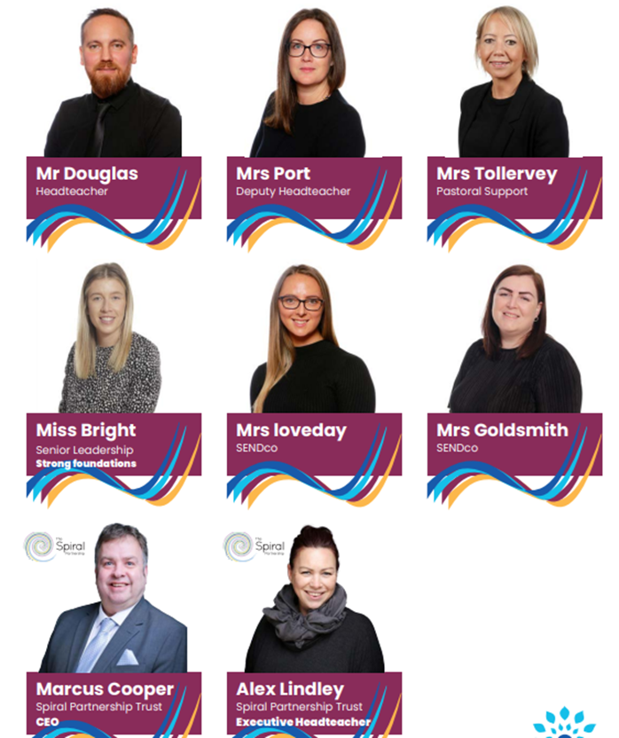
Spiral Leadership Team

Slide 3
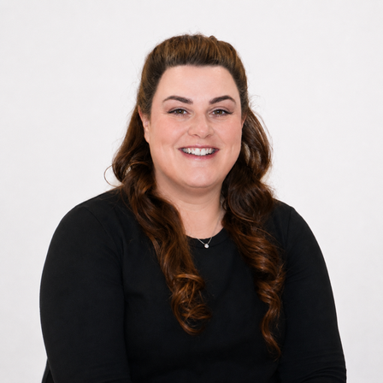
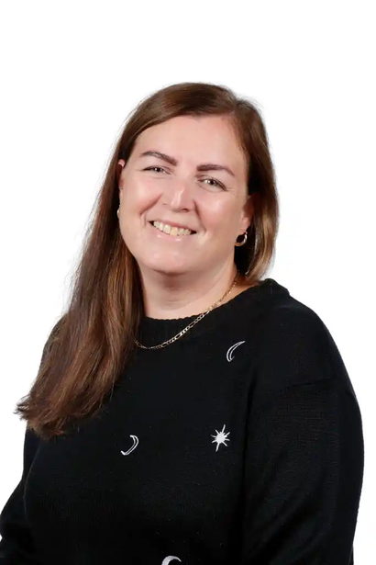
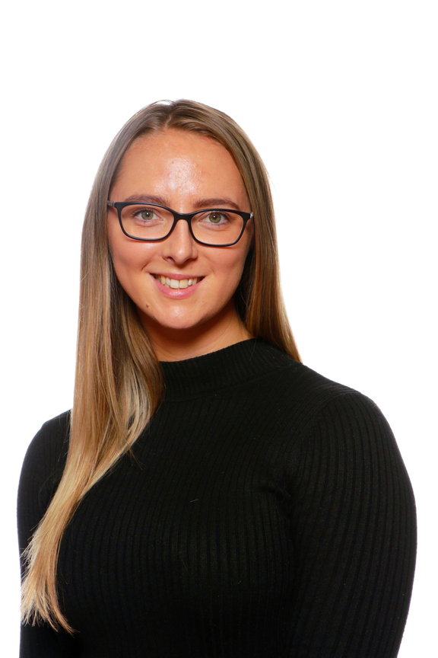
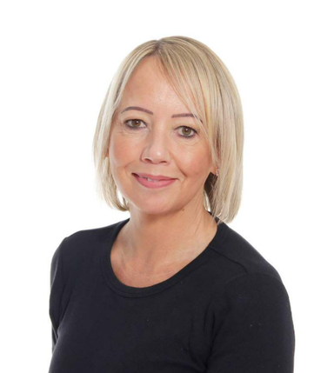
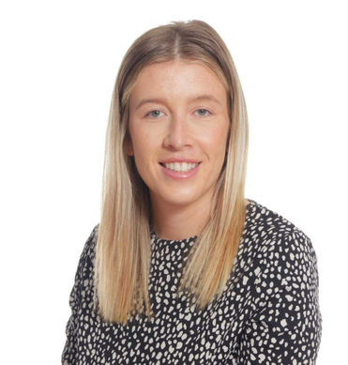
Forres Leadership Team
Mrs Fitts
Headteacher
Mrs Loveday
SENDco
Miss Bright
EYFS/KS1 Lead
Miss Goldsmith
Deputy Headteacher
Mrs Tollervey
Pastoral Lead

Slide 4
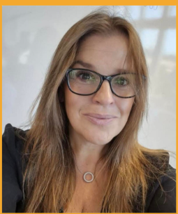
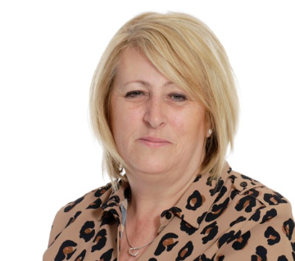

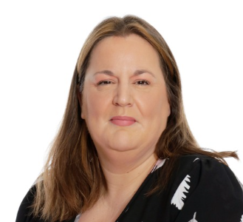
MEET THE
Teaching Team
Mrs Payne
Miss Luxford
Miss Hill

Slide 5

Vision and Values

Slide 6
A typical day in Year 6
8:45am-9am: Early Morning work
9.05-9.20am: Assembly
9.20-10.00am: Reading
10.00 – 11.00 - English
11.00-11.15pm: Break
11:15-12:10pm: Maths
12.15-1.15pm Lunch
1.15-1.30pm – Handwriting
1.30 – 2.20pm – Geography
2.20 – 3.00pm – Computing
3.00 – 3.15 –DEAR

Slide 7
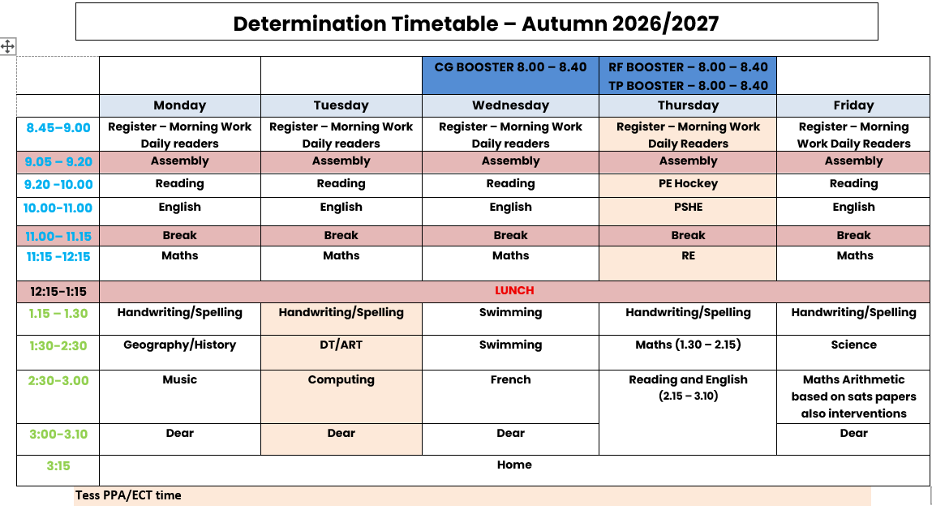
Weekly Timetable

Slide 8

Curriculum Overview

Slide 9
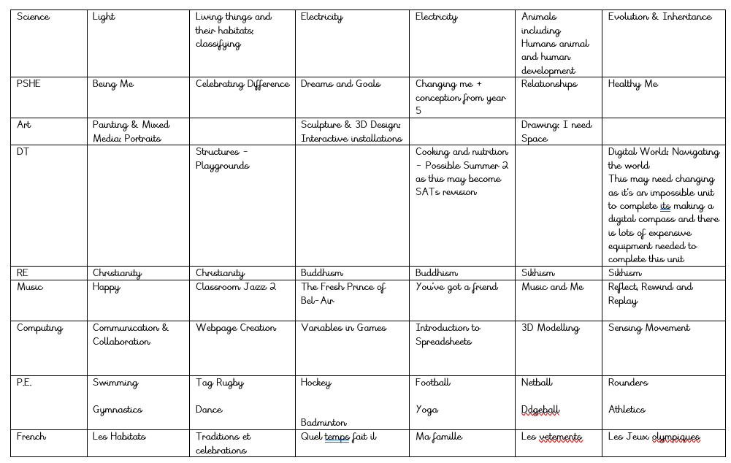
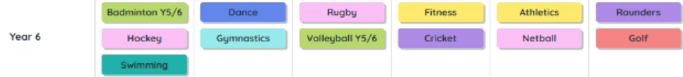
Curriculum Overview

Slide 10
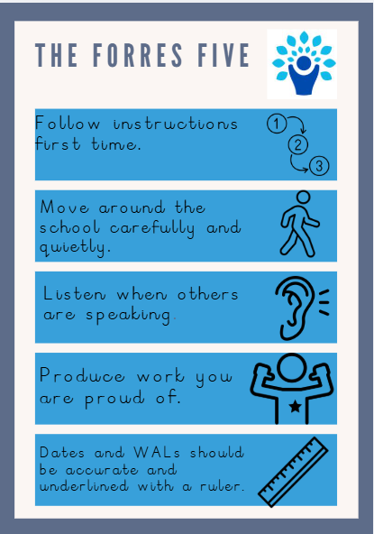
The Forres Five

Slide 11

Phonics, Early Reading,Reading

Slide 12
Home Learning
As a school we believe in children practicing their basic skills and do not set onerous homework to complete.
Our expectation is that children read every day, at least 5 times a week and practice their spellings and multiplication.
In year 6 there may be additional tasks set online or via worksheets to help target pupil's individual needs

Slide 13
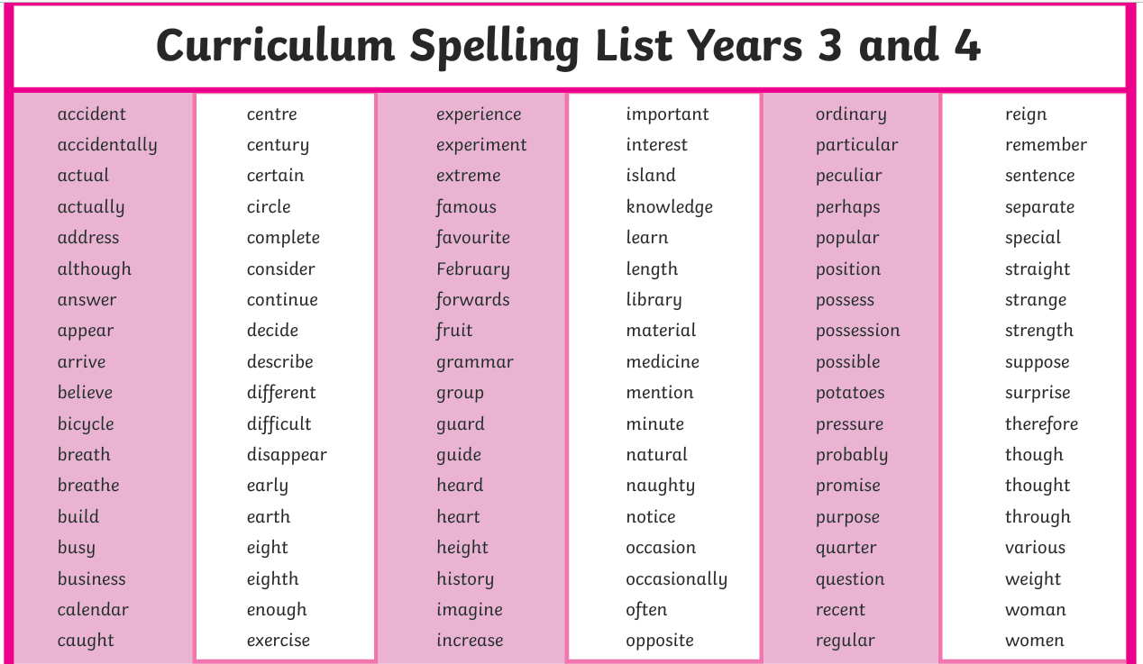

Slide 14
Attendance
Small amounts of absence quickly add up
90% attendance means missing around 1 day every two weeks.
Over a school year, that's approximately 19 days of learning missed.
Across primary school, this can amount to almost half a year of education.
Strong attendance leads to better achievement
Children who attend school regularly are more likely to reach expected standards in reading, writing and maths.
Better attendance in primary school lays the foundation for success in secondary school and beyond.
School is about belonging | Parents and schools are partners
Children who attend regularly are more likely to: feel part of the school community take part in clubs and events develop a sense of pride and belonging. | The biggest impact on attendance comes from families and schools working together to: establish consistent morning routines communicate early about concerns support children who may be anxious celebrate good attendance.

Slide 15
Allergies
-No food will be given out in school,
so please no edible items for birthdays or celebrations.
-We are a nut free school, please no items containing nuts in packed lunch boxes.
-All educational visits will be carefully planned and prepared for, should your child have an allergy.
-All staff will be aware of Health Care plans for children with allergies and follow accordingly.

Slide 16
Enrichment Opportunities
Key Dates/trips
Every Wednesday from now until Christmas - Swimming
14th September – individual school photos
15th September – Crucial Crew- Miss Goldsmith will be supporting
21st September - Mock Sats week
23rd September – Boosters start (individual invites will be sent as targeted this year)
23rd September - Grafham intro meeting 14th - 16th April Grafham
30th September – Learning Plan review meetings
1st October – Flu vaccine whole school
14th October – Parents evening
15th October – School nurse
22nd October – School Disco
23rd October – Inset day
10th May – SATS week
6th July – Leaver’s production
16th July – Leaver’s disco

Slide 17
Statutory Assessments
EYFS: Reception Baseline
(6 weeks into Autumn 1)
Year 1 Phonics Screening - June
Year 2 Phonics Re-screening - June
Year 4 Multiplcation Check - June
Year 6 SATs - Week beginning Monday 10th May 2027

Slide 18
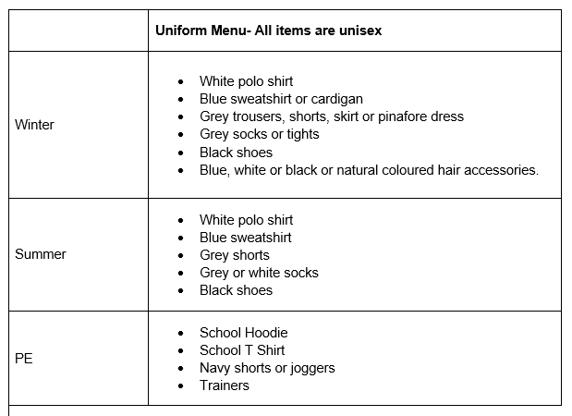
Uniform
Hair should always be up.
No nail varnish
No colourful trainers
No colourful hair accessories

Slide 19
Communication at Forres
Throughout the year we will communicate in a variety of ways:
•Face to Face
•Marvellous Me
•Email
•Newsletters
•Letters
•Website
•Phone calls and Text Messages

Slide 20
Any questions?

